Slide 1
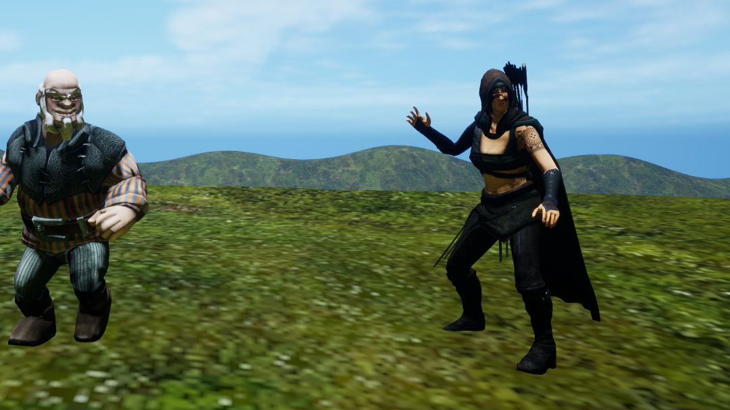
Witch Hunt
by Unreal Worms

Slide 2
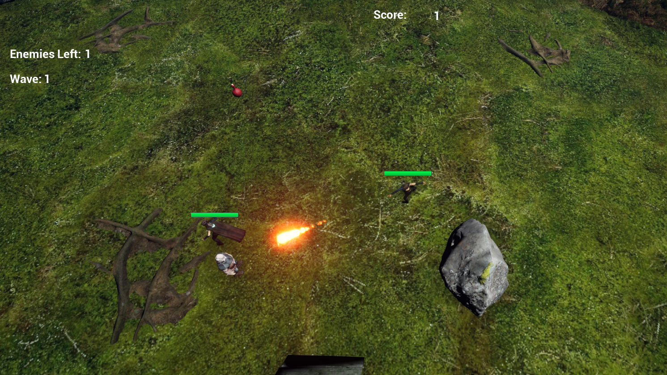
Co-op top down ARPG
Steam Multiplayer
Mouse click movement
Spell system
Waves of enemies
Health Pickups

Slide 3

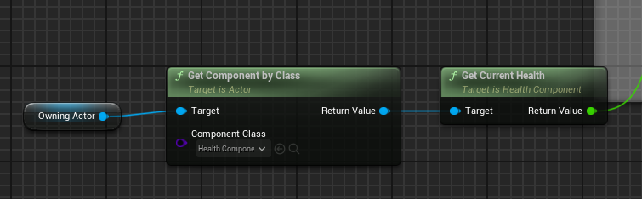
Design Pattern
Health Component
Smart use of Components
High Modularity
Smart use of C++/Blueprint interaction
Health Widget
Player Class
Has A
Spell Casting Component
Has a
Spell Base class
Parent of
Fireball spell class
Has A
Health Component
Has a
UI Widget

Slide 4
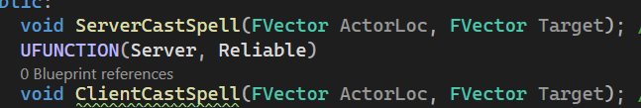

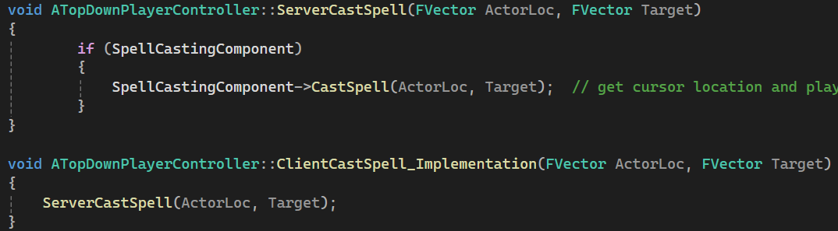
Steam Multiplayer
Massive headache
Pay attention to replication
RPC (Remote Procedure Calls)

Slide 5
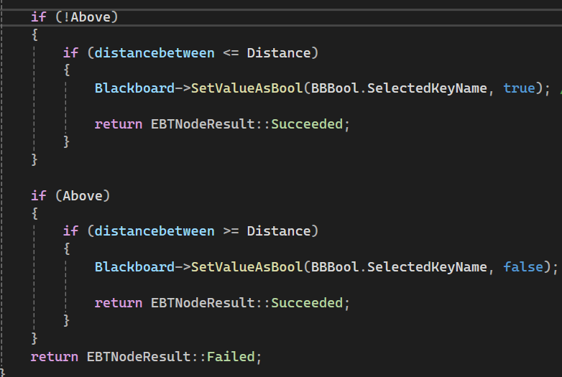
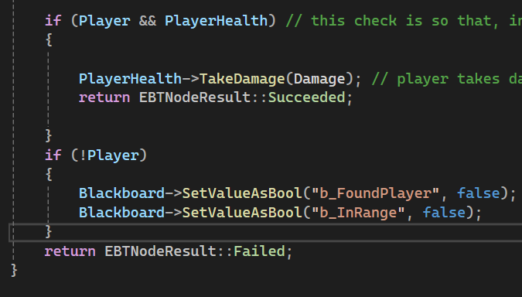
Enemy AI
Behaviour tree
C++ allows more specific and complex behavior
Faster logic needed for large number of NPCs
More comprehensive features
Check distance node
Attack node

Slide 6
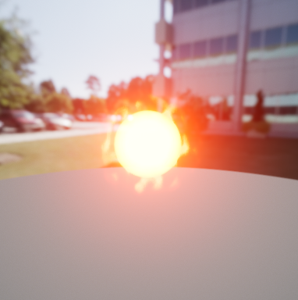
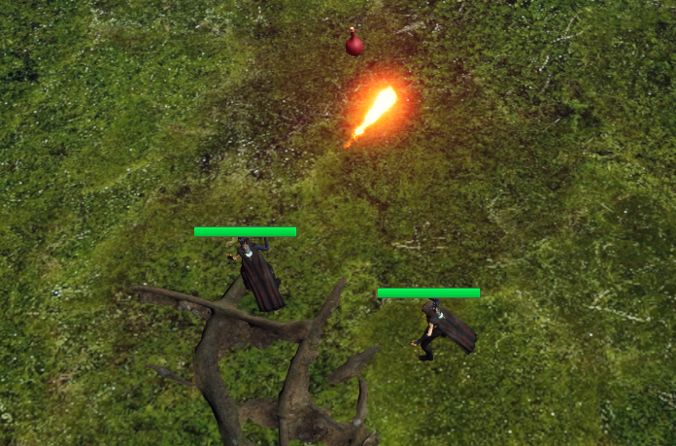
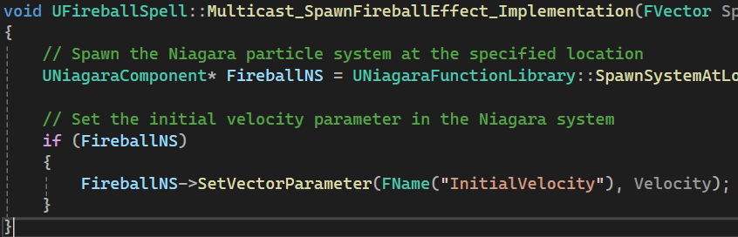
UI and Niagara
UI replication
Niagara replication
Event tick solves everything (the wrong way)

Slide 7
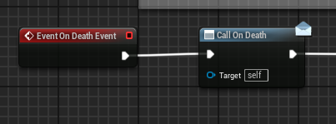
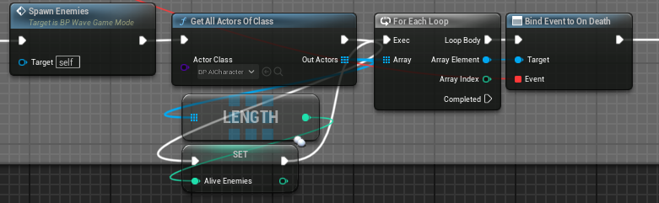
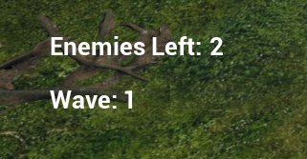
Gamemode
Enemy Blueprint
Why we did it mostly using blueprint
Asyncronous logic with event dispatchers
Event dispatchers are great for communicating with other things like UI
Gamemode Blueprint

Slide 8
Asset providers
Quixel
Moore Game Dev

